Slide 1

fcfs scheduling & lru page replacement algorithm
By: Sathkeerthi y Agnihothri & shyam prasad m
GITHUB Link : https://github.com/5th-sem-OS-tut/FCFS-LRU

Slide 2
Overview of presentation
FCFS Scheduling algorithm
LRU page replacement algorithm
Project Members

Slide 3

First come, first serve [FCFS]
SCHEDULING ALGORITHM

Slide 4
Fcfs scheduling overview
What is FCFS?
Why is FCFS scheduling algorithm useful?
Some disadvantages of FCFS scheduling
FCFS implementation using C++
Output sample

Slide 5

First come, first serve [fcfs]
Simplest scheduling algorithm.
process that comes first will be executed first and next process starts only after the previous process gets fully executed.

Slide 6

Why is FCFS scheduling algorithm useful?
Very simple, and they operate on the order of arrival time, no switching and complications.
Easy to implement into any system.
As calculating the algorithm for orders is so simple, it is easy for team members of any experience or skill level to manage order scheduling and write and understand code with ease, thus easy to implement.

Slide 7
Disadvantages of fcfs
Any process that has low execution time suffers, since waiting time is long.
Lower CPU and resource utilization, i.e not efficient.
Process with large burst time will keep the resources for long time, thus other processes will have to wait for long time unnecessarily (Convey Effect).
For time-sharing systems, it is essential that each user get a share of the CPU at regular intervals. Because FCFS is a non-preemptive system, this is not always feasible.

Slide 8
Step1: Take the set of processes as the input with the corresponding arrival time and burst time.
Step2: Sort these processes based on their arrival time in ascending order.
Step3: The process with least arrival time is executed completely and corresponding completion time, turn-around time and waiting time are updated.
Turn-around Time = Completion Time - Arrival Time
Waiting Time = Turn Around Time - Burst Time
Step4: The Process that comes first will be executed first and next process starts only after the previous process gets fully executed.
Step5: Repeat Step4 until all the processes are executed completely.
Step6: Find the average turn-around time, average waiting time.
Average Turn-Around Time = Sum of all turn-around time/no. of processes
Average Waiting Time = Sum of all waiting time/no. of processes
ALGORITHM

Slide 9
FCFS implementation using C++
#include <iostream>
#include <algorithm>
#include <iomanip>
using namespace std;
struct Schedule
{
string pro_id;
int artime,bt,ct,tat,wt;
// artime = Arrival time,
// bt = Burst time,
// ct = Completion time,
// tat = Turn around time,
// wt = Waiting time };

Slide 10
bool compare(Schedule p1,Schedule p2)
{
return p1.artime < p2.artime;
/* To sort the processes according to the order of their Arrival Times */
}
bool revind(Schedule p1,Schedule p2)
{
return p1.pro_id < p2.pro_id;
/* To revert back the processes in the order of process id */
}
int main()
{ Schedule process[100];
//An array of Processes int cpunon=0; int n,i;
//n = number of processes, i= iteration variable float percentage;
cout << "------\nINPUT\n------" << flush;
cout << "\nEnter the number of processes: " << flush;
cin >> n; cout << "Enter the Process id, Arrival time and Burst time of the " << n << " processes :" << endl;

Slide 11
for(i=0;i<n;i++){
cin>>process[i].pro_id;
cin >> process[i].artime;
cin >> process[i].bt;
}
sort(process,process+n,compare);
/* Sort is a predefined function defined in algorithm.h header file,
it will sort the processes according to their arrival times */
cpunon=process[0].artime-0;
// initial values process[0].ct=process[0].artime+process[0].bt;
process[0].tat=process[0].ct-process[0].artime;
process[0].wt=0;
for(i=1;i<n;i++){
if(process[i].artime<=process[i-1].ct){
process[i].ct=process[i-1].ct+process[i].bt;
process[i].tat=process[i].ct-process[i].artime;
process[i].wt=process[i].tat-process[i].bt;
}
else{
process[i].ct=process[i].bt+process[i].artime;
process[i].tat=process[i].ct-process[i].artime;
process[i].wt=process[i].tat-process[i].bt;
cpunon+=process[i].artime-process[i-1].ct;
}
}

Slide 12
percentage=(float)((process[n-1].ct-cpunon)/process[n-1].ct)*100;
cout<< endl << "-------\nOUTPUT\n-------" << endl;
sort(process, process+n, revind);
cout << "\n\tP#\t AT\t BT\t CT\t TAT\t WT\t\n\n" ;
double total_tat = 0.0;
double total_wt = 0.0;
for(i=0;i<n;i++)
{
//keep all statements in one line
cout<<"\t"<<process[i].pro_id<< "\t"<<process[i].artime<<"\t"<<process[i].bt<<"\t"<<process[i].ct<<"\t"<<process[i].tat<<"\t "<<process[i].wt;
total_tat += process[i].tat;
total_wt += process[i].wt;
cout<<endl;
}
cout << fixed << setprecision(2)<< endl;
cout<<"Average Turn Around Time: "<<(total_tat/n)<<"\n";
cout<<"Average Waiting Time: "<<(total_wt/n)<<"\n";
return 0;
}

Slide 13
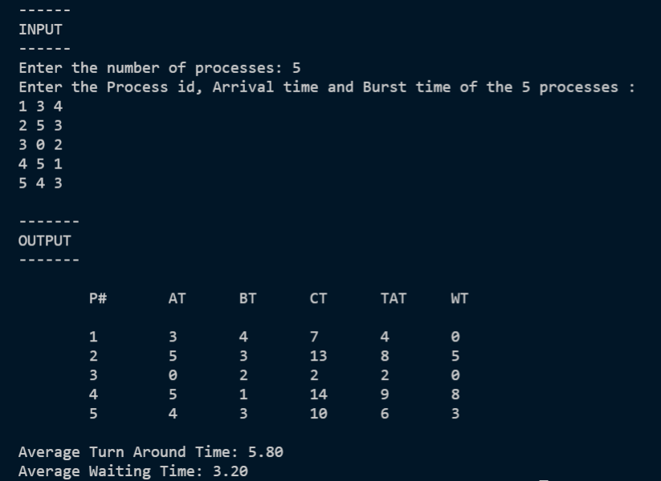
Sample output

Slide 14

LEAST RECENTLY USED [LRU]
PAGE REPLACEMENT ALGORITHM

Slide 15
LRU PAGE REPLACEMENT overview
What is LRU Page Replacement Algorithm?
Advantages of LRU
Disadvantages of LRU
LRU implementation using C++
Output sample

Slide 16

WHAT IS LRU PAGE REPLACEMENT ALGORITHM?
This algorithm stands for "Least Recently Used" and this algorithm helps the Operating system to search those pages that are used over a short duration of time frame.
It works on the concept that pages that have been highly used in the past are likely to be significantly used again in the future.
It removes the page that has not been utilized in the memory for the longest time.

Slide 17

Advantages of LRU
LRU doesn't suffer from Belady's Anomaly.
The page in the main memory that hasn't been used in the longest will be chosen for replacement.
It gives fewer page faults than any other page replacement algorithm. So, LRU is the most commonly utilized method.
It is a very effective algorithm.
It helps in the full analysis.

Slide 18
Disadvantages of LRU
LRU's weakness is that its performance tends to degenerate under many quite common reference patterns.
It isn't easy to implement because it requires hardware assistance.
It is expensive and more complex.
It needs an additional data structure.

Slide 19
ALGORITHM
We set ‘nopages’ to be the number of pages that
memory can hold. Let frame array be the current set
of pages in memory and let count hold number of page
faults.
Traversing the pages:
If {frame array holds less pages than nopages},
1) Insert page into the frame array one by one until the size of frame array reaches capacity or all page requests are processed.
2) Simultaneously we maintain the recent occurred index of each page in an array called fcount.
3)We then increment count.
Else If {current page is present in frame array },we do
nothing.
Else
1) We find the page in the frame array that was least recently used. We find it using fcount array. We basically need to replace the page with minimum index.
2) Then we replace the found page with current page.
3) We then increment count.
4) Then update index of current page in fcount.
Calculating number of hits, Hit ratio, Miss
ratio:
Number of hits = nopages - count
Hit ratio = (nopages - count)*100/nopages
Miss ratio= (Count) *100/nopages

Slide 20
implementation OF LRU PAGE REPLACEMENT ALGORITHM using C++
#include<iostream>
using namespace std;
int main()
{
int nopages, nofaults, page[20],i ,count=0;
cout<<"Enter the Number of pages :\t";
cin>> nopages;//it will store the number of Pages
cout<<"\nEnter the Reference String :\t";
for(i=0;i< nopages;i++)
{
cout<<"";
cin>>page[i];
}
cout<<"\nEnter the Number of frames:\t";
cin>> nofaults;

Slide 21
int frame[nofaults],fcount[nofaults];
for(i=0;i< nofaults;i++)
{
frame[i]=-1;
fcount[i]=0;//it will keep the track of when the page was last used
}
i=0;
while(i< nopages)
{
int j=0,flag=0;
while(j< nofaults)
{
if(page[i]==frame[j])//it will check whether the page already exist in frames or not
{
flag=1;
fcount[j]=i+1;
}
j++;
}
j=0;
cout<<"\n\t\n";
cout<<"\t"<<page[i]<<" ->";
if(flag==0){
int min=0,k=0;
while(k<nofaults-1)
{
if(fcount[min]>fcount[k+1])
//It will calculate the page which is least recently used
min=k+1;
k++;
}

Slide 22
frame[min]=page[i];
fcount[min]=i+1;
count++; //It will count the total Page Fault
while(j< nofaults) {
cout<<"\t|"<<frame[j]<<"|";
j++;
}
} i++;
}
cout<<"\n\nNumber of Page Faults :"<<count;
cout<<"\n\nNumber of Hits :"<<nopages - count;
cout<<"\n\nHit Ratio: "<<(nopages - count)*100/nopages
<< "%" << endl;
cout<<"\nMiss Ratio: "<<(count)*100/nopages
<< "%" << endl;
cout<<"\n";
return 0;
}

Slide 23
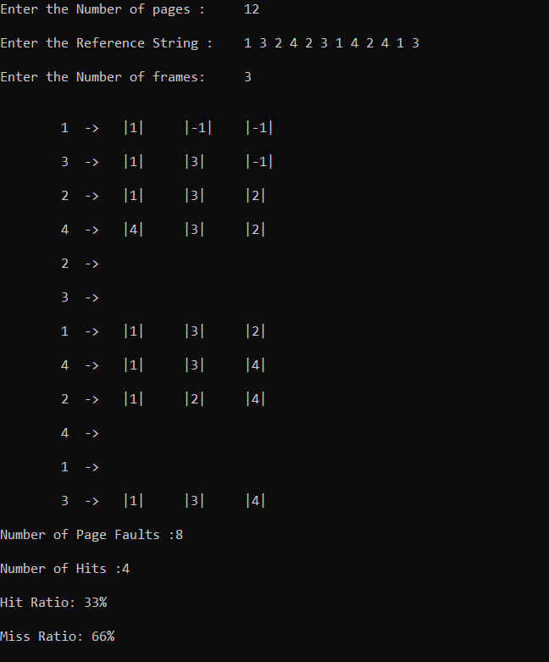
Output sample

Slide 24
PROJECT MEMBERS
Sathkeerthi Y Agnihothri 4NI19CS099
Shyam Prasad M 4NI19CS106

Slide 25

Thank You

